Slide 1
WELCOME TO THE LIVE DEMO ON ANGULAR-14
By Mr. SANJAY KUMAR

Slide 2
Introduction
I am Sanjay Kumar
8+ years of corporate experience as a Full-Stack developer.
5+ years of experience as a trainer.
2+ years With NareshIT.

Slide 3
Training Roadmap
Course Duration : 2 months
Class Time : 1 hour daily 8.30am to 9.30am
Working days: Monday to Saturday (Sunday-off)
JavaScript - 2 weeks
Angular - 4 weeks
Others - 1 week(Resume, Interview, Project, Unit Testing)

Slide 4
JavaScript Content
Datatypes
Variables
Use strict
Functions
Math
String
Array
Object
OOPS
Closure
Prototypes
Call , bind , apply
Date & Time
setTimeout , setInterval
callBack , Promise , Async Await
REST Parameter
De-structuring
Modules
Generators

Slide 5
Angular Content
Angular Installation
Angular vs AngularJS
Angular CLI
Component
Module
Data binding
View Encapsulation
Inbuilt Directives
Custom Directives
Pipes
Custom Pipes
Component Communication
LifeCycle Methods / Hooks
Services
Dependency Injection
HttpClient / AJAX
Interceptors
Observables (RxJs)
Form
Routing
Lazy Loading
NgRx (State management)
Build & Deploy
Angular Material
Unit testing (Jasmine + Karma)

Slide 6
Course Objective / Take Away
Learn programming fundamentals and object-oriented programming concepts.
To learn new technologies
Learn to Incorporate best practices
common libraries and tools - POSTMAN, Git, GitHub, VScode, JSON-server
tools and techniques for debugging
Server Interaction (Send and receive data) using JSON and Ajax.
Enable to develop a web application using HTML, CSS, Bootstrap, JavaScript.

Slide 7
Training Highlights
Designed for both beginners & experienced candidates.
Hands on exercises
Realtime examples on every topic.
Assignments
Mock Interview
Resume preparation
Placement Assistance
Class recordings (1 year)
Notes (google classroom / GitHub)

Slide 8
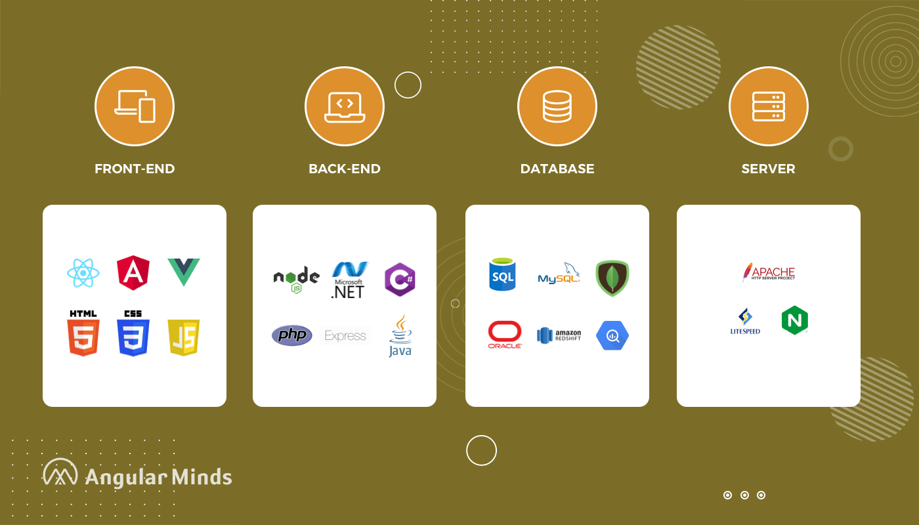
Web Development Stack

Slide 9
What is Web Development
Website Development
Front-End : User Interface (HTML, CSS, Javascript, Angular/React)
Back-End : Processing (Java, .NET, PHP, python, NodeJS)
Database : Data Storage (oracle, mysql, mongoDB)
Server : Apache Tomcat , WebLogic , Glassfish

Slide 10
Front-End Technologies
HTML | Content ( paragraph,image,table,list,audio,form,video)
CSS | Styling (color,border,width,height,background-color,positioning)
Bootstrap | predefined css , Responsiveness
Javascript | Behaviour
Angular/React/Vue | JavaScript Frameworks RAD - Rapid Application Development CLI - Command Line Interface A Template System Reusable components Synchronization of state and view Routing Form Validation Better AJAX

Slide 11
Tools & Softwares
1. browser (IE/firefox/chrome) - json viewer
2. Editor (vscode/sublimetext/atom)
3. online editors (jsbin,codepen,jsfiddle)
4. Json-server , POSTMAN ,json viewer
5. Git-software
https://git-scm.com/downloads
6. github - create profile
https://github.com/sanjaysamantra1

Slide 12
Commonly Asked Questions
Course Duration : 2 months
Class Time : 1 hour daily 8.30am to 09.30am
Working days: Monday to Saturday (Sunday-off)
Pre-Requisite - HTML , CSS
Laptop configuration - any
Mode of training – online
How Many Demo Sessions – 3 Sessions
Fee - NareshIT Admin/management
Notes - Google Drive, GitHub
Recording - google Classroom
Admin - 8179191999(office)
Mute: you are allowed to interact anytime during the session once actual class starts

Slide 13
Commonly Asked Tech Questions
Why Angular?
AngularJS vs Angular
New Things in Angular-14?

Slide 14
React Vs Angular
React Angular
===========================================================
1. Library-2013 1. Framework-2009
2. Light-weight 2. Heavy
3. JSX + Javascript 3. HTML + Typescript
4. Uni-Directional 4. two-way
5. Virtual DOM 5. Regular DOM
6. Axios 6. HttpClientModule
7. No 7. Dependency Injection
8. No 8. Form Validation
9. extra libraries needed 9. No additional libraries
10. UI heavy 10. Functionality heavy

Slide 15
AngularJs vs angular
AngularJs Angular
1. Javascript 1. Typescript
2. MVC 2. Component
3. CLI-No 3. CLI
4. filters 4. Pipes
5. Controller 5. Controller-No
6. $scope,$rootscope 6. NO-(component class)
7. Unit testing 7. Unit testing - better
8. mobile devices-No 8. mobile devices-yes

Slide 16


